Slide 1




NEXT GEN EMPLOYABILITY PROGRAM
Creating a future-ready workforce
Student Details:
College Name:
Student Name :D.PARTHIBAN
Student ID :au513521104033
Annai Mira College of Engineering and Technology.

Slide 2

CAPSTONE PROJECT SHOWCASE
Project Title
Building Bus Reservation System using Python and Django
Abstract | Problem Statement | Project Overview | Proposed Solution | Technology Used | Modelling & Results | Conclusion

Slide 3
Abstract :
The Bus Reservation System (BRS) is an essential component of modern transportation management, facilitating the efficient booking and management of bus tickets. This system aims to streamline the process of ticket reservation for passengers, while providing administrators with tools for effective fleet management and monitoring.
For administrators, the BRS provides comprehensive functionalities for managing bus schedules, assigning routes, and tracking ticket sales. Integration with GPS technology enables real-time monitoring of bus locations, optimizing operational efficiency and enabling timely interventions in case of contingencies.
In summary, the Bus Reservation System revolutionizes the bus ticketing process by offering a seamless booking experience for passengers and empowering administrators with the tools to streamline operations, enhance service quality, and maximize efficiency in the transportation industry.
Bus Reservation System is a tool that allows users to book tickets for their journey in advance. It offers multiple features to provide a hassle-free experience to a traveler.
Source :

Slide 4
Problem Statement :
Inefficient manual ticketing processes leading to long queues and delays for passengers, especially during peak times, highlighting the need for a streamlined and automated booking system.
Limited accessibility to accurate information regarding bus schedules, seat availability, and fares, causing confusion and dissatisfaction among passengers, necessitating a centralized and transparent reservation platform.
Challenges in effective seat management, resulting in overbooking or underutilization of available seats, leading to revenue loss and operational inefficiencies, emphasizing the requirement for a dynamic seat inventory management system within the Bus Reservation System.
Security concerns surrounding manual ticketing systems, including errors, fraud, and unauthorized access to passenger data, highlighting the necessity for robust security measures and secure transaction processing within the Bus Reservation System to protect passenger information and ensure trustworthiness.
Source :

Slide 5
Project Overview :
Purpose and Scope: The Bus Reservation System aims to revolutionize the ticketing process by providing passengers with a user-friendly platform to book bus tickets efficiently while offering administrators tools for effective fleet management. It encompasses functionalities for online booking, real-time seat availability updates, secure payment processing, and bus tracking.
Key Features: Online Booking: Passengers can search for available routes, select preferred seats, and make reservations seamlessly through web and mobile interfaces. Real-time Seat Availability: The system provides up-to-date information on seat availability, enabling passengers to make informed decisions. Secure Payment Processing: Robust security measures are implemented to ensure the safety of financial transactions, protecting passenger data and preventing fraud.
Implementation Plan: Requirement Analysis: Gather and analyze requirements from stakeholders including passengers, bus operators, and administrators. Design and Architecture: Design system architecture, database schema, and user interfaces based on the analyzed requirements.
Technology Stack: 1. Frontend 2. Database 3. Security 4. Backend: Node.js or Django
Source :

Slide 6
Proposed Solution :
.
Online Booking Platform: Develop a user-friendly web and mobile app for seamless reservations, integrating real-time seat availability updates and secure payment processing for convenience.
Dynamic Seat Management: Implement a responsive seat allocation system that optimizes seat utilization, preventing overbooking and providing accurate availability information instantly.
Comprehensive Administration Dashboard: Create an intuitive dashboard for bus operators to manage schedules, track sales, and monitor bus locations in real-time, empowering informed decision-making.
Integration with GPS Technology: Utilize GPS technology to enable precise bus tracking, offering passengers accurate arrival times and enhancing overall travel planning and experience.
Robust Security Measures: Implement stringent security protocols to safeguard passenger data and financial transactions, ensuring privacy and trust in the system's integrity.
Source :

Slide 7
Scalability: Design the system to accommodate future growth and scalability requirements. Seamless Integration with Existing Systems: Ensure compatibility and seamless integration with existing transportation management systems and databases.
Regular Updates and Maintenance: Provide regular updates and maintenance to ensure system reliability and performance.
Compliance with Regulations: Adhere to regulatory requirements and industry standards for data privacy, security, and accessibility.
User Training and Documentation: Provide comprehensive user training materials and documentation for passengers and operators.
Continuous Improvement: Commit to continuous improvement through feedback analysis, technology updates, and market research to enhance the overall user experience
Source :

Slide 8
Automated Notifications: Send automated notifications to passengers regarding booking confirmation, seat assignments, and trip updates.
Feedback Mechanism: Implement a feedback system to gather passenger insights and improve service quality continuously.
Accessibility Features: Ensure accessibility compliance with features such as screen readers and keyboard navigation for passengers with disabilities.
Multi-Language Support: Provide multi-language support to cater to a diverse range of passengers.
Data Analytics: Utilize data analytics to gain insights into booking trends, passenger preferences, and operational efficiencies.
GPS Integration: Utilize GPS technology for precise bus tracking, providing passengers with accurate arrival times and enhancing travel planning.
Source :

Slide 9


Technology Used
Front-end
Back-end
Source :

Slide 10
Modelling & Results
Data Flow Diagram: Develop a comprehensive data flow diagram illustrating the flow of information within the system, including passenger booking, seat allocation, payment processing, and bus scheduling.
Database Schema: Design an efficient database schema to store and manage crucial data such as passenger details, bus schedules, seat availability, and transaction records, ensuring scalability and performance.
User Interface Mockups: Create user interface mockups depicting the booking platform for passengers and the administration dashboard for operators, facilitating intuitive navigation and efficient management of system functionalities.
Performance Metrics: Define performance metrics such as booking completion time, seat utilization rate, revenue generated per route, and customer satisfaction scores to evaluate the effectiveness and efficiency of the Bus Reservation System.
Source :

Slide 11
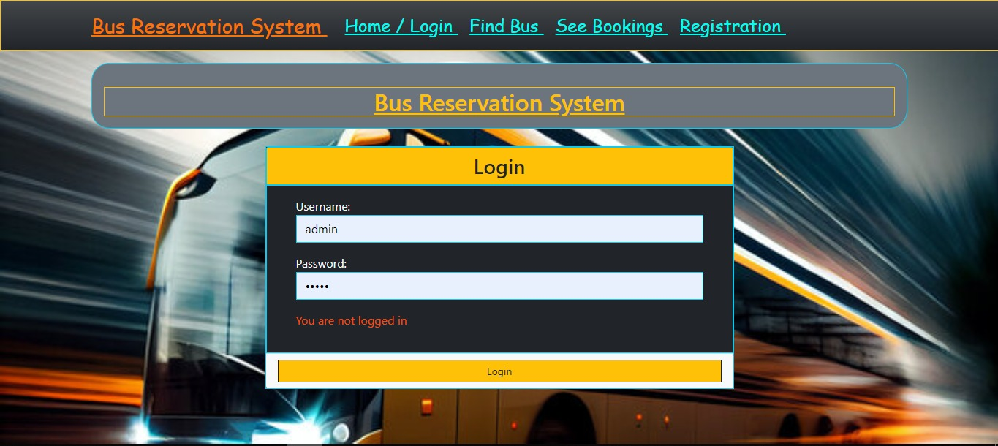
Homepage

Slide 12
About-Us-Page
Welcome to our Bus Reservation System! We are committed to revolutionizing the way people travel by providing a seamless booking experience and optimizing fleet management for bus operators.
Our Mission: To simplify travel arrangements and enhance the overall experience for passengers and bus operators through innovative technology and exceptional service.
What We Offer: Our Bus Reservation System offers a user-friendly platform for passengers to book bus tickets conveniently, check real-time seat availability, and make secure payments. For bus operators, we provide comprehensive tools for managing schedules, tracking sales, and optimizing fleet operations through our intuitive administration dashboard.
Why Choose Us: With our commitment to reliability, security, and customer satisfaction, we strive to be the preferred choice for both passengers and bus operators.
Join us on this journey as we continue to innovate and redefine the future of bus travel. Thank you for choosing our Bus Reservation System for your travel needs.

Slide 13
Service-Page
Online Booking: Our user-friendly web and mobile app allows passengers to search for bus routes, check seat availability in real-time, select preferred seats, and make secure reservations, offering a convenient booking experience.
Real-time Updates: Stay informed with real-time updates on seat availability, bus schedules, and arrival times, ensuring passengers have accurate information at their fingertips to plan their travel efficiently.
Secure Payment Processing: With robust security measures in place, passengers can make online payments securely, using various payment options, ensuring peace of mind and protecting their sensitive financial information.
24/7 Customer Support: Our dedicated customer support team is available round-the-clock to assist passengers with booking inquiries, resolve issues, and provide assistance throughout their journey, ensuring a seamless travel experience.

Slide 14
Departments-Page
Passenger Services Department: This department focuses on providing assistance and support to passengers throughout their journey, including handling inquiries, resolving issues related to bookings or payments, and ensuring a smooth travel experience.
Fleet Management Department: Responsible for managing the fleet of buses, this department oversees scheduling, route planning, vehicle maintenance, and driver assignments to ensure efficient operations and adherence to safety standards.
Technical Support Department: Offers technical assistance and troubleshooting for both passengers and staff, ensuring that the Bus Reservation System functions smoothly and addressing any issues related to the booking platform, payment processing, or GPS tracking.
Finance and Accounting Department: Manages financial transactions, including ticket sales, refunds, and revenue reporting. This department also handles billing and invoicing for corporate clients, ensuring accurate financial records and compliance with accounting standards.

Slide 15
Blog-Page
Introduction: Explore the challenges faced by passengers and bus operators in the traditional ticketing process and introduce the concept of a modern Bus Reservation System to streamline booking and enhance efficiency.
Key Features: Highlight the essential features of the Bus Reservation System, including online booking, real-time seat availability updates, secure payment processing, GPS integration for bus tracking, and comprehensive administration dashboard for fleet management.
Benefits: Discuss the benefits of the Bus Reservation System, such as improved user experience, optimized fleet operations, enhanced transparency, increased security, and potential for future enhancements to adapt to evolving passenger needs.
Case Studies/Testimonials: Share success stories or testimonials from users who have experienced the convenience and efficiency of the Bus Reservation System, illustrating its impact on improving travel experiences and operational effectiveness.

Slide 16
Future Enhancements:
AI-Powered Recommendation System: Implement AI algorithms to analyze passenger preferences and recommend personalized travel options, enhancing user satisfaction and increasing ticket sales.
Dynamic Pricing Mechanism: Introduce dynamic pricing based on factors like demand, time of booking, and route popularity, optimizing revenue generation while offering competitive fares to passengers.
Augmented Reality Seat Selection: Integrate augmented reality technology into the booking platform to allow passengers to visualize and select seats virtually, improving the booking experience and reducing potential conflicts during seat selection.
Integration with Smart Transportation Ecosystem: Extend integration with smart city initiatives and emerging transportation technologies like autonomous vehicles and ride-sharing services to offer seamless multimodal travel experiences and enhance overall connectivity.

Slide 17
Conclusion :
Enhanced User Experience: The implementation of the Bus Reservation System significantly improves the booking experience for passengers by offering a user-friendly platform with real-time seat availability, secure payment processing, and convenient booking options.
Efficient Fleet Management: The system empowers bus operators with comprehensive tools for managing schedules, tracking sales, and monitoring buses in real-time through an intuitive administration dashboard, leading to optimized fleet operations and enhanced decision-making.
Improved Transparency and Accountability: With features such as dynamic seat management and GPS integration, the system ensures transparency in seat availability and accurate bus tracking, fostering trust among passengers and enhancing operational accountability.
Enhanced Security and Compliance: Robust security protocols safeguard passenger data and financial transactions, ensuring compliance with regulatory requirements and industry standards, thereby instilling confidence in the system's integrity and reliability.
Source :

Slide 18
Thank You!
Notes:
Thank You !!

